Slide 1
LAB NO: 2
INTERFACING LED TO ARM MICROCONTROLLER

Slide 2
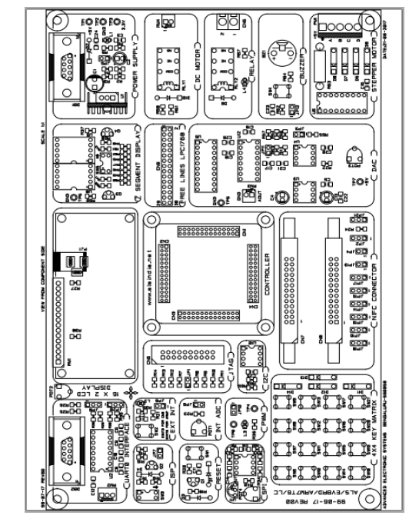

Slide 3
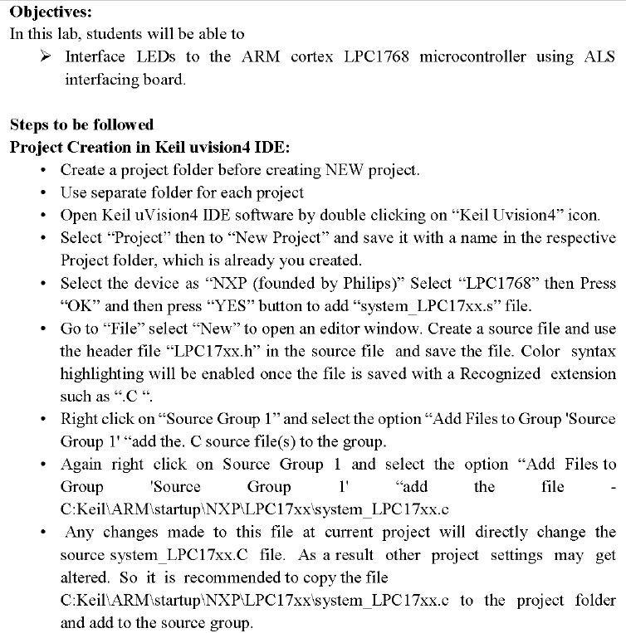

Slide 4
#include <LPC17xx.H>
int main(void)
{
LPC_PINCON->PINSEL1 = 0x00000000; //P0.24,P0.25 GPIO
LPC_GPIO0->FIODIR = 0x03000000; //P0.24 configured output for buzzer,P0.25 configured output for Relay/Led
while(1)
{
if(!(LPC_GPIO2->FIOPIN & 0x00000800)) //Is GP_SW(SW4) is pressed??
{
LPC_GPIO0->FIOSET = 0x03000000; //relay on
}
else
{
LPC_GPIO0->FIOCLR = 0x03000000; //relay off
}
}
}

Slide 5

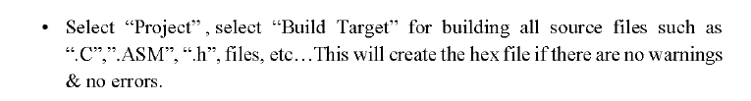

Slide 6
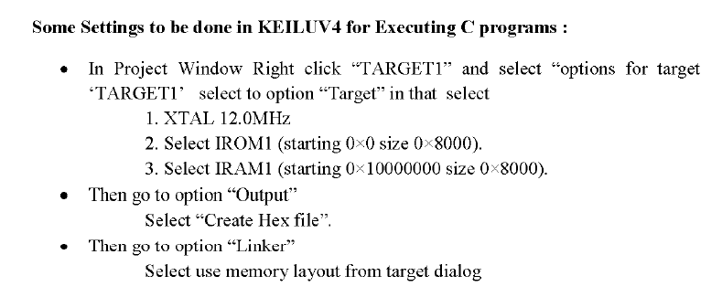

Slide 7
